Slide 1
SHAUUUUUUUUUN: 4th Progress Report
Gravity Xscape
John Frazia, Matthew Nagy, and Oliver Rayner

Slide 2
General Summary
Done
We have level transitions through the entire game.
Menus and next level triggers are set up.
Doing
Replacing prototype with final world tiles (update them).
Player death script Implementation.
To Do
Create credits page.
Find, test, and fix small bugs in the game.

Slide 3

Detailed Summary (John)
Worked on the music for the game, have a work in progress version for the main theme and a MVP for the pre-gravity shift section.
Tried some fixes for the walking sound playing when not grounded and/or not moving, nothing definite yet.
Continued on sfx work and implementation within the project itself.
Cleaned up Audio Asset List.

Slide 4

Detailed Summary (Matt)
Reworked old scripts to support the levels created in tiled better.
Bug fixes for movement and collisions.
Added a key and door system.
Allows the player to pick up keys that are used when attempting to enter a locked door.
In progress player death.
Colliding with undesirable objects in the environment and being spotted by guards.

Slide 5
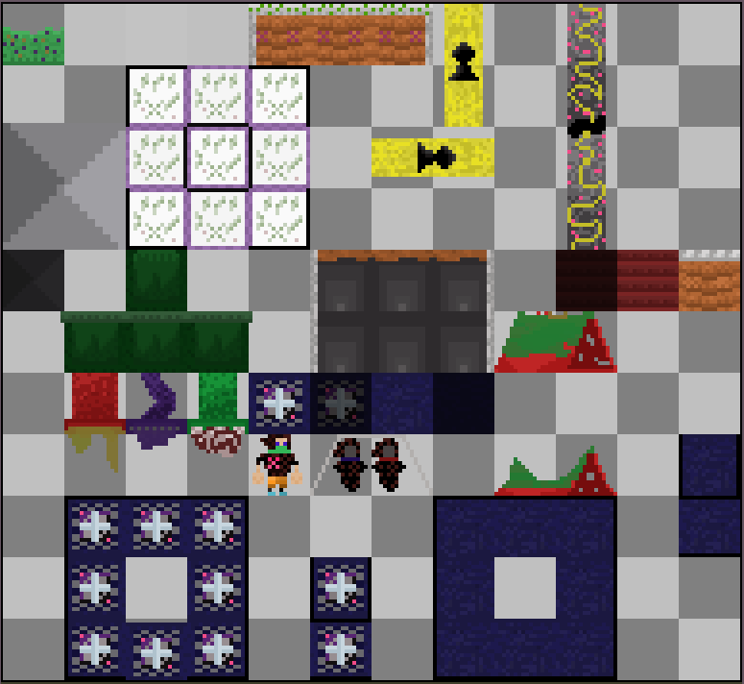

Detailed Summary (Oliver)
Updated animator of the Thief.
Created menus and scene transitions.
Made the building assets to replace prototype.
Player dies a very pleasant death.
Background flip fixed.
Micro Myers

Slide 6
Data
Presented by You

Slide 7
Data Talk
A majority of the class did not like the pink walls (great we did not like them either).
A couple people noted there is no easy way of exiting the game (fixed with menu implementation).
A majority of participants did not know how to gravity shift (we are currently working on a way to show through UI).
Evenly distributed answers on dystopian experience goal (putting more effort into world storytelling).
Slopes? (this was split 50/50).

Slide 8
Triumphs & Setbacks
Triumphs:
Upgraded the visuals of the levels.
Item system for keeping track of keys picked up.
Game is more user friendly.
Setbacks:
Ran into a lot of merge conflicts within the Unity compiler (Get fixed ASAP).
Do not have all assets in the game yet.

Slide 9
Honest Assessment
Some parts were faster to implement than others.
We are on schedule.
Make a final compiled Trello list.
Continue this positive mood to the finish line.
Do not write a report while solving merge conflicts.

Slide 10
Questions?

